Slide 1
Muse Monitor
Medical alert system for Detecting seizures and fall from hospital patients
Presented by basheer becerra
Notes:
Introduction
Go through Outline

Slide 2
Terminology
AMS (altered mental status): Disruption of brain functionality (i.e. concussion, high fever, etc)
EEG (electroencephalogram): A device that detects electrical activity in brain
Accelerometer: Measures the movement and acceleration of the device
Gyroscope: Measures the orientation of the device
Muse headband: Device that utilizes EEG, accelerometer, and gyroscope for personal and portable use.

Slide 3
Problem Statement
Some injuries and incidents are difficult to detect using traditional monitoring systems. This results in greater injury and higher hospital expenses.
Neurological
Seizure, awareness (during anesthesia), concussion, stroke, and other abnormalities.
Physical
Falls, aches, and other physical pains/symptoms

Slide 4
Problem Statistics
Between 700,000 and 1,000,000 patients fall in hospitals each year¹
30-51% of these falls result in serious injuries.
Operational cost of $13,000 with 6.5 days added to the patient’s stay after fall injuries.²
Out of all patients admitted with AMS, 7% had seizures during hospitalization, and 13.4% of patients had increased risk of seizures.³
¹ Dykes, Patricia C., et al. "Fall prevention in acute care hospitals: a randomized trial." Jama 304.17 (2010): 1912-1918.
² Joint Commission. "Preventing falls and fall-related injuries in health care facilities." Sentinel event alert 55 (2015): 1.
³ Bardi, Jason. "EEG Identifies Seizures in Hospital Patients, UCSF Study Finds." UC San Francisco. Jason Bardi, 27 Mar. 2013. Web. 17 Apr. 2017
Notes:
According to the Agency for Healthcare Research and Quality: 7-1
According to Joint Commission- 13000 extra
According to Mayo Clinic Proceedings, 7% of patients admitted with AMS or spells had seizures during hospitalization, and 13.4% of patients had increased risk of seiezures.³
Some patients may have spell-symptoms, but are not seizures. EEG can prevent the treatment of anti-epileptic medications.
Dr. John Betdemman – UCSF professor in nuerology
AMS = Altered Mental Status
AMS includes
Concussion
Very high fevers
Low oxygen levels
Low or high blood sugar levels
Heart attack
Dehydration
Thyroid disease
Urinary tract infection
John Betjemann MD, states EEG as underutilized diagnostic tool.
Underutilized due to affordability and portability
This is underutilized due to the lack of 24-hour coverage, however, most seizure’s can be detected by EEG within the first hour.
The 3. article also provides lots of solution statements to the seizure problem

Slide 5
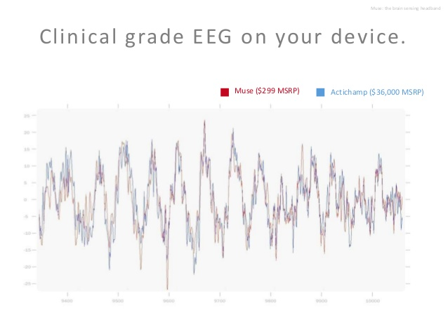
Idea: Muse Monitor (1/2)
Utilize the Muse Headband data to detect neurological and physical incidents in patients
Portable
Comprehensive
Affordable
Accurate
Notes:
Detect incidents: specifically we’re detecting seizures and falls
Muse Headband
Affordable
$300 – making it affordable by hospitals
By assisting injuries quickly, may reduce overhead cost
Portable
Monitoring device that is worn as a headband
Comprehensive
Describe the data that it retrieves: EEG, acceleration, orientation
Contains EEG data to detect seizures, Acceleration and orientation to detect falls
Accurate
Through these above aspects, I can see this this solution used extensively by our target market: hospitals and other clinical facilities.

Slide 6
Idea: Muse Monitor (2/2)
Steps
Raw data streamed from Muse Headband to Android device
Android device, as a proxy and filter, streams received data to online socket
Socket analyzes data and streams determined indicators to web client
Web client visualizes data and alerts user on emergency event.

Slide 7
Demonstration
Link to web client: Here
Link to Android mirror app: Here

Slide 8
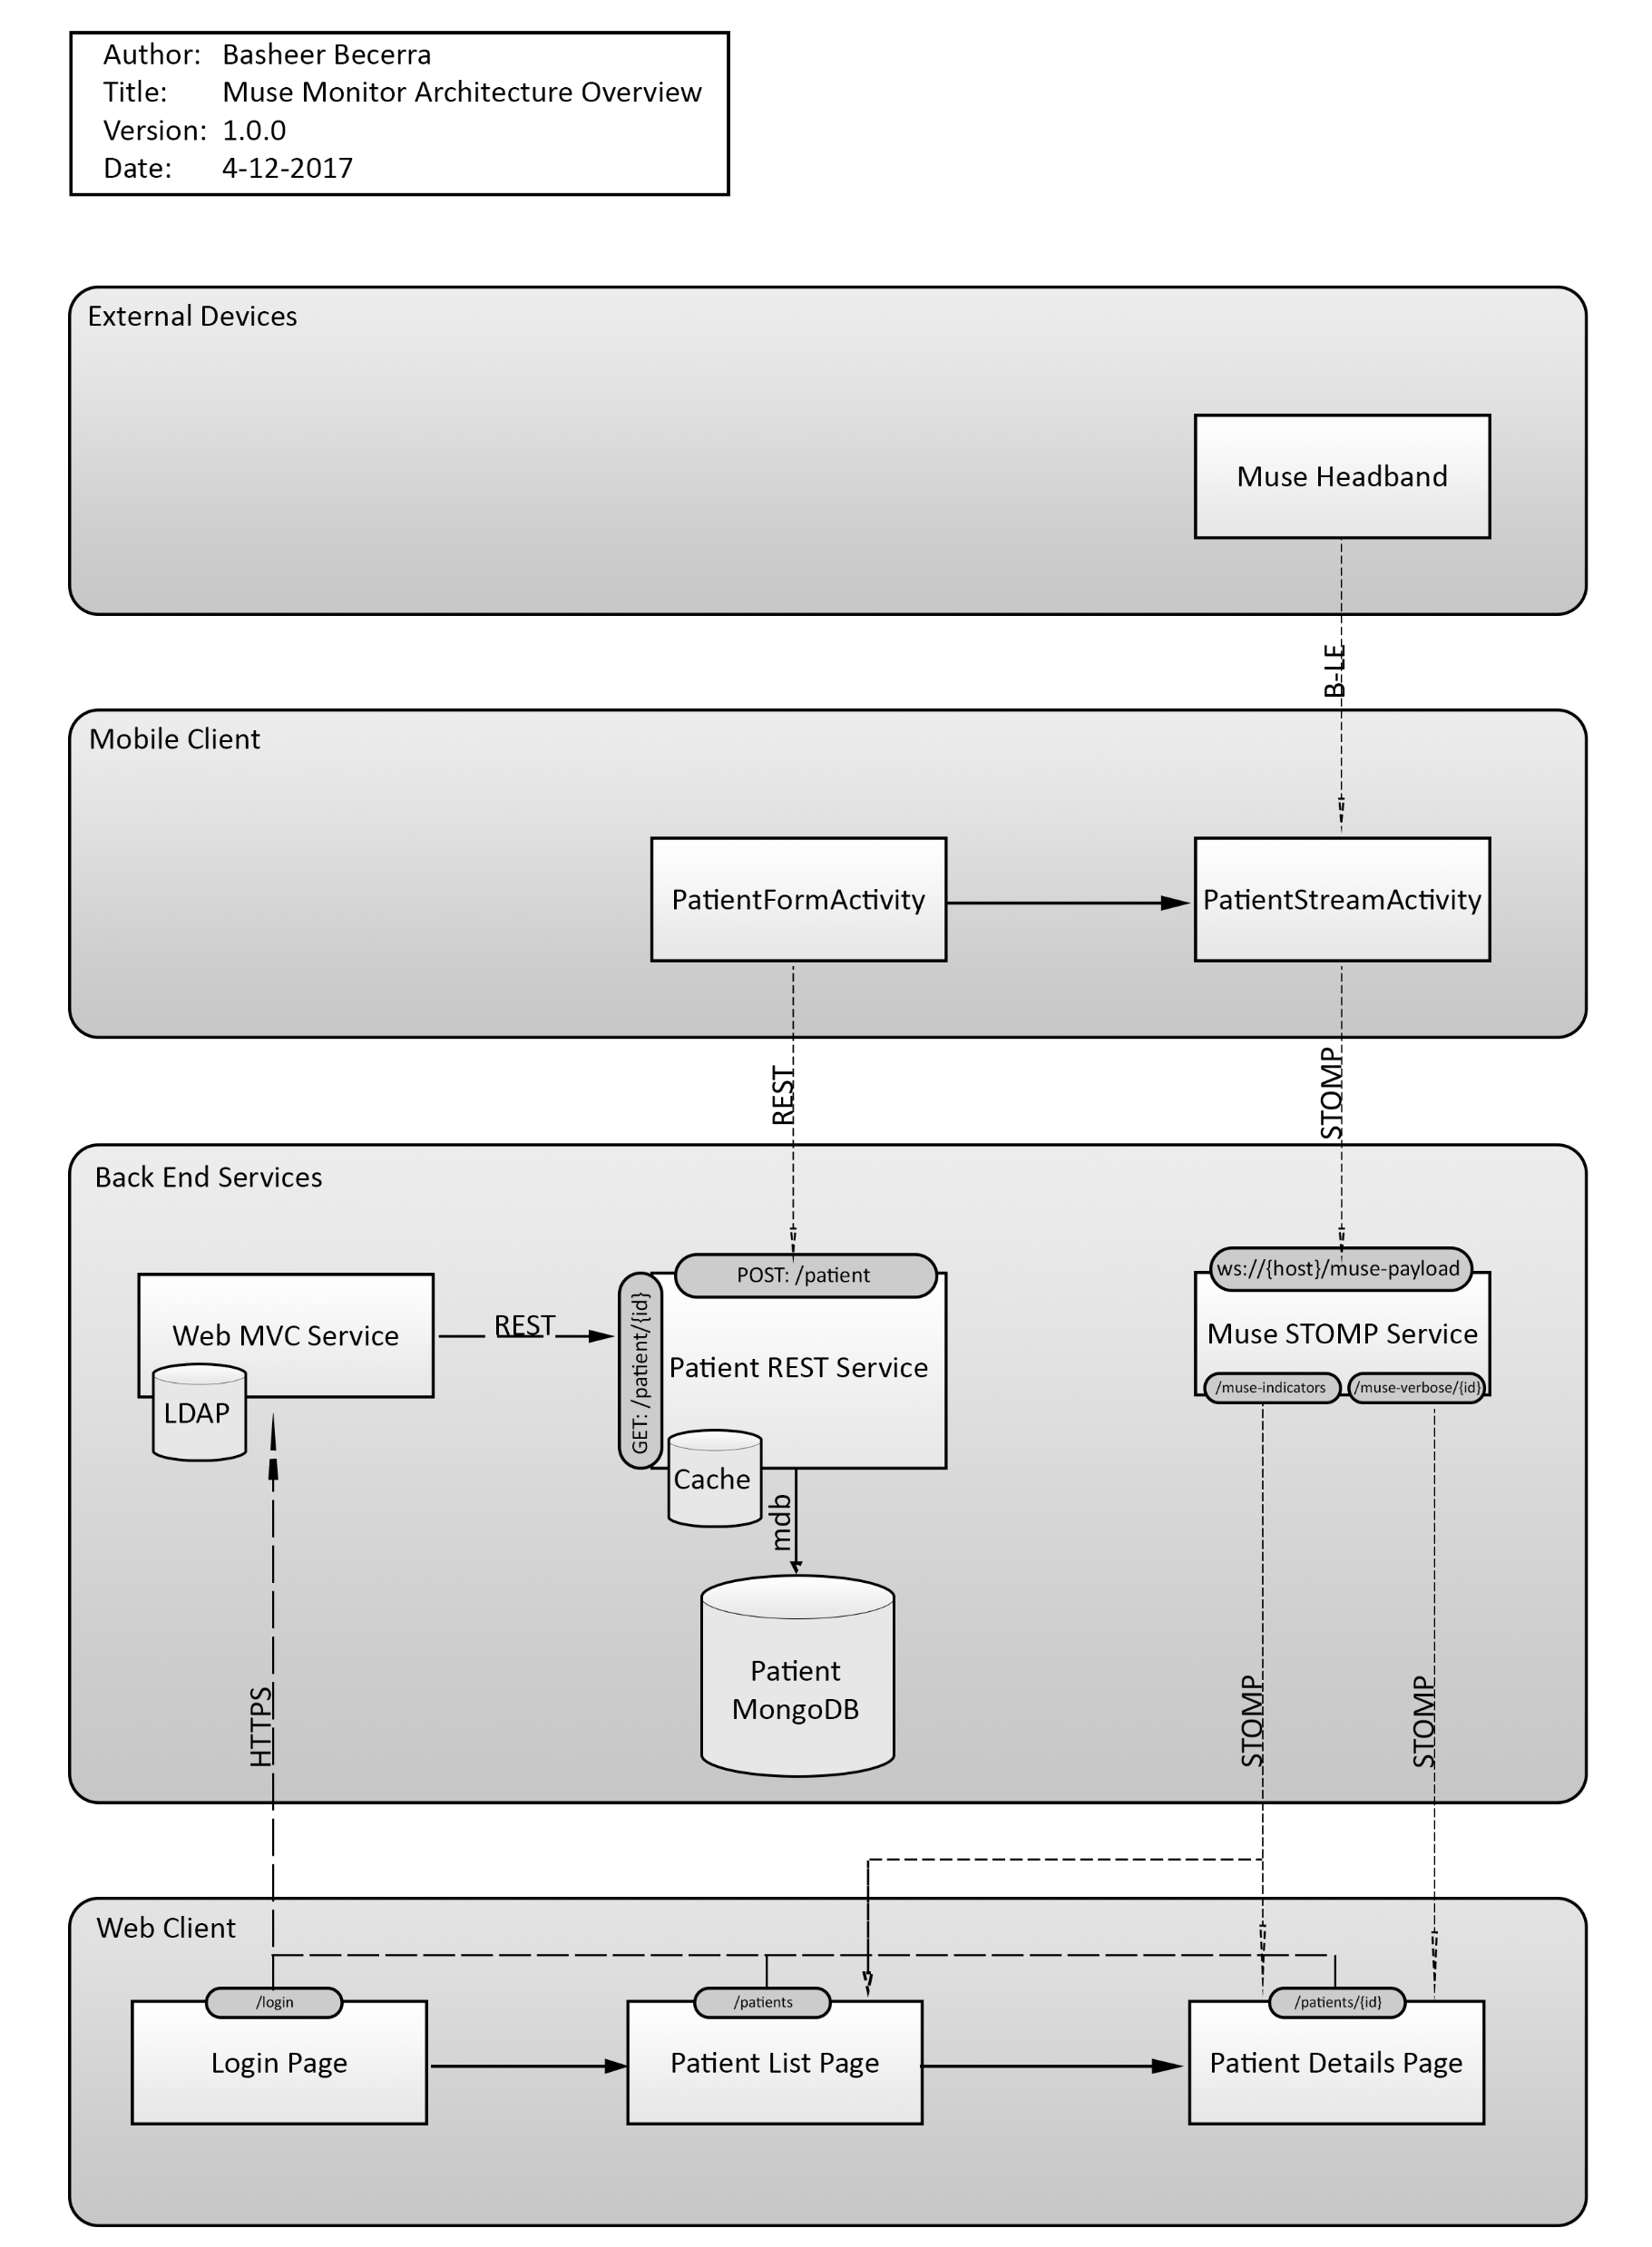
Technical Overview: Architecture

Slide 9
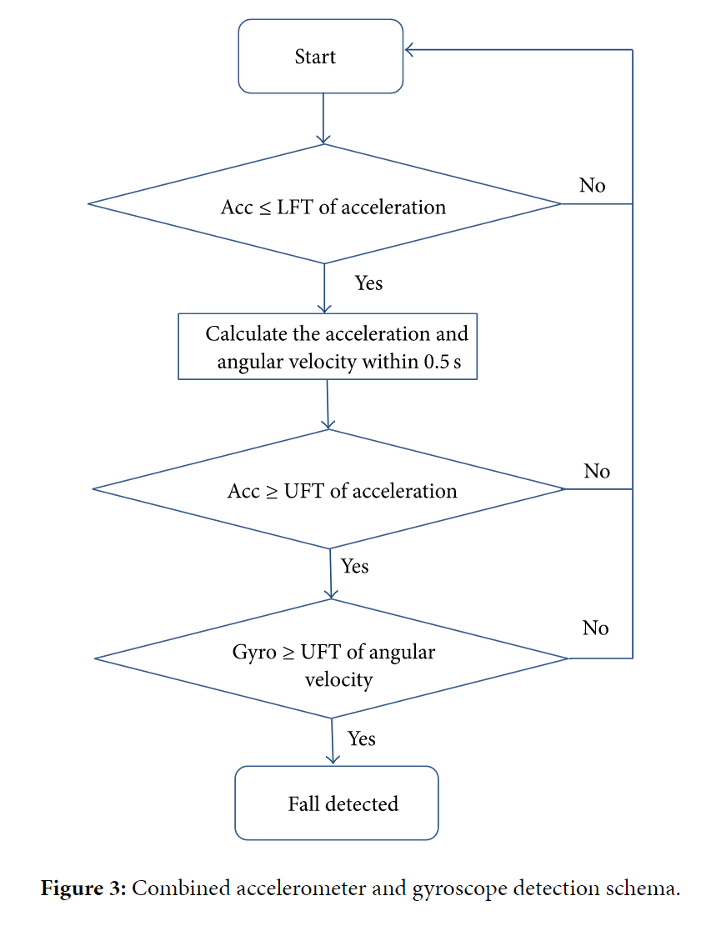
Technical Overview: Fall Detection
¹ Huynh, Quoc T., et al. "Optimization of an accelerometer and gyroscope-based fall
detection algorithm." Journal of Sensors 2015 (2015).
Notes:
Explain Flow Diagram
Explain trials
Had to do several trials to determine thresholds to ensure that accuracy, recall, and precision were optimal

Slide 10
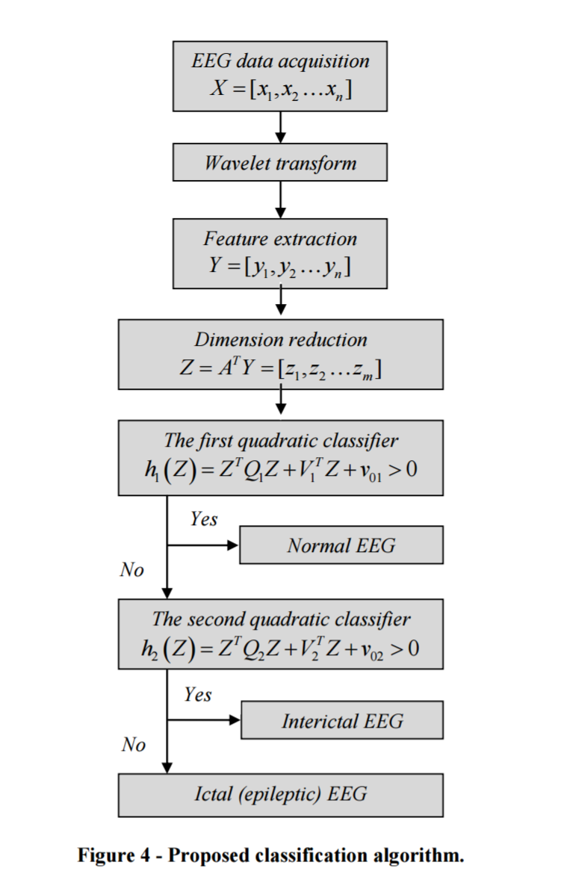
Technical Overview: Seizure Detection
¹ Gajic, Dragoljub, et al. "Classification of EEG signals for detection of epileptic seizures
based on wavelets and statistical pattern recognition." Biomedical Engineering:
Applications, Basis and Communications 26.02 (2014): 1450021.
Notes:
Briefly explain complexity of flow diagram
Emphasize on the 3 classifiers
Difficulty differentiating between interical and ictal (explain definition)
Slightly manipulated the algorithm to only have two classifiers: seizure or no seizure
Had to do several analysis to determine the variables for the algorithm
Took extensive amount of Math
Emphasize on difficulty
3-4 weeks were spent doing research and reading several papers to find an appropriate algorithm, and doing trials to determine any variables for the algorithms.
Rest of time (only 2-3 weeks) were spent on creating the whole app and system

Slide 11
Potential
Potentially, the application can retrieve meaningful insights and metrics about a patient’s well-being during hospital care.
Perhaps a single device can detect neurological properties, physical movement, cardiac properties, etc.
After implemented in hospitals, the all-in-one device can be used for personal use.
Notes:
Vision
Retrieve metrics for hospital decisions
Also for research
I only found one resource online with available EEG data for research.
Single device, many properties
Technology still has a long ways to go to make these monitors affordable and small enough to fit in a single device.
Use for personal care
True vision – I would like to see a world where most physical-emergency calls are done automatically.
No manual calling or pressing a button on life alert.
I see a huge market opportunity for this idea with an opportunity to save many lives.

Slide 12
Citations
CODE/DOCUMENTATION/POWERPOINT: https://github.com/CodingBash/muse-monitor
Dykes, Patricia C., et al. "Fall prevention in acute care hospitals: a randomized trial." Jama 304.17 (2010): 1912-1918.
Joint Commission. "Preventing falls and fall-related injuries in health care facilities." Sentinel event alert 55 (2015): 1.
Bardi, Jason. "EEG Identifies Seizures in Hospital Patients, UCSF Study Finds." UC San Francisco. Jason Bardi, 27 Mar. 2013. Web. 17 Apr. 2017
Huynh, Quoc T., et al. "Optimization of an accelerometer and gyroscope-based fall detection algorithm." Journal of Sensors 2015 (2015).
Gajic, Dragoljub, et al. "Classification of EEG signals for detection of epileptic seizures based on wavelets and statistical pattern recognition." Biomedical Engineering: Applications, Basis and Communications 26.02 (2014): 1450021.
Andrzejak, Ralph G., et al. "Indications of nonlinear deterministic and finite-dimensional structures in time series of brain electrical activity: Dependence on recording region and brain state." Physical Review E 64.6 (2001): 061907.
Notes:
Vision
Retrieve metrics for hospital decisions
Also for research
I only found one resource online with available EEG data for research.
Single device, many properties
Technology still has a long ways to go to make these monitors affordable and small enough to fit in a single device.
Use for personal care
True vision – I would like to see a world where most physical-emergency calls are done automatically.
No manual calling or pressing a button on life alert.
I see a huge market opportunity for this idea with an opportunity to save many lives.

Slide 13
Conclusion
Notes:
Now to conclude my presentation, I want to say a final statement: My true vision for this idea is to truly see a world where emergency calls are mostly made automatically. No need to dial a phone number or even press a button. I believe that my idea is a start for saving lives and fulfilling my vision.

Slide 14
Questions?

